Slide 1
Vijaya Lakshmi Masabathula
Final Project
3/21/2024 Annual Review

Slide 2
KeyLogger&Security
Keyloggers are a type of malicious software (malware) designed to record and capture every keystroke made on a computer's keyboard. They are often used by cybercriminals to steal sensitive information such as passwords, credit card numbers, and other personal data. Keyloggers can be hardware-based or software-based.
Hardware Keyloggers: These are physical devices that are plugged into the keyboard or installed within the computer's hardware. They capture keystrokes directly from the keyboard.
Software Keyloggers: These are programs that run silently in the background, recording keystrokes and sending the captured data to an attacker. They can be installed through malicious downloads, phishing emails, or exploit vulnerabilities in software.
3/21/2024 Annual Review

Slide 3


AGENDA
Problem statement
Project overview
Who are the end users?
Solution and its value proposition
The wow in your solution
Modelling
Results
Project Link
3/21/2024 Annual Review

Slide 4

PROBLEM STATEMENT
Keyloggers pose a significant threat to information security by covertly capturing keystrokes to steal sensitive information such as login credentials, financial data, and personal information. These malicious tools can be hardware-based or software-based and are often used by cybercriminals to gain unauthorized access to private accounts and systems. Despite existing security measures, keyloggers continue to evolve, making it challenging to detect and prevent their infiltration.
The primary objective is to develop comprehensive and robust solutions that can effectively detect the presence of keyloggers, mitigate their impact, and enhance user awareness to prevent their installation. This involves the integration of advanced detection techniques, proactive security practices, and user education to safeguard sensitive information from being compromised by keylogger attacks.
3/21/2024 Annual Review

Slide 5

PROJECT OVERVIEW
Objective:
Develop solutions to identify, mitigate, and prevent keylogger attacks, protecting sensitive information.
Key Components:
Detection Mechanisms: Enhance antivirus software, use machine learning for behavioral analysis, and detect hardware keyloggers.
Preventive Measures: Regular software updates, firewall configurations, and secure authentication with 2FA and password managers.
User Education: Conduct training programs and awareness campaigns on phishing and safe practices.
Response Protocols: Implement incident response plans, continuous monitoring, and regular security audits.
3/21/2024 Annual Review

Slide 6

WHO ARE THE END USERS?
Cybercriminals: The primary end users, using keyloggers to steal sensitive information such as login credentials, credit card numbers, and personal data for financial gain or identity theft.
Industrial Spies: Individuals or entities using keyloggers to gather confidential business information, trade secrets, and competitive intelligence from rival companies.
Disgruntled Employees: Employees who may use keyloggers to collect sensitive information from their employers for sabotage, theft, or personal revenge.
Governments and Intelligence Agencies: Entities using keyloggers for surveillance and intelligence gathering on individuals or groups of interest, both domestically and internationally.
Private Investigators: Individuals who might use keyloggers in investigations to monitor and gather evidence on suspects, often in cases of fraud, infidelity, or other personal matters.
3/21/2024 Annual Review

Slide 7

YOUR SOLUTION AND ITS VALUE PROPOSITION
The Keylogger Detection and Prevention Project offers a comprehensive security framework designed to detect, prevent, and respond to keylogger threats. The solution encompasses the following components:
Enhanced Detection Mechanisms:
Advanced Antivirus and Anti-malware
Behavioral Analysis Tools
Hardware Scanning Tools
Enhanced Security: Comprehensive detection and prevention mechanisms significantly reduce the risk of keylogger attacks, protecting sensitive information from unauthorized access.
Proactive Protection: Regular updates, firewalls, and secure authentication practices ensure systems are resilient against evolving keylogger threats.
User Empowerment: Through education and training, users become the first line of defense, able to recognize and avoid potential keylogger installations.
3/21/2024 Annual Review

Slide 8
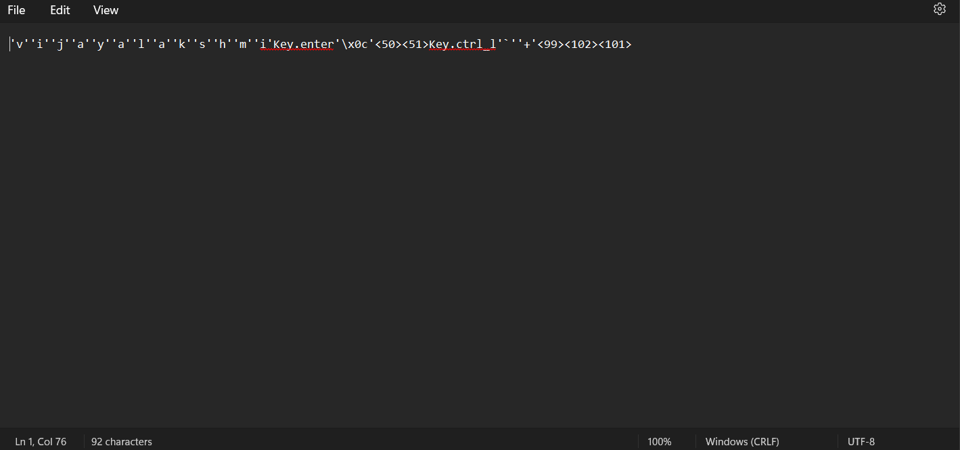

THE WOW IN YOUR SOLUTION
3/21/2024 Annual Review
8

Slide 9
MODELLING
Machine Learning-Based Behavioral Analysis:
Data Collection: Aggregates data on normal user behaviors and keylogger patterns from keystroke dynamics, application usage, and network traffic.
Feature Extraction: Identifies key features such as typing speed, unusual key sequences, and unexpected application behaviors.
Model Training : Utilizes machine learning algorithms like anomaly detection and neural networks trained on the extracted features to differentiate between normal and suspicious activities.
Real-Time Monitoring: Deploys these models to continuously monitor user activities, flagging anomalies that indicate potential keylogger presence.
Signature-Based Detection:
Signature Database: Maintains an updated database of known keylogger signatures, including patterns and code snippets.
Scanning Tools: Develops and utilizes tools to scan systems for these known signatures, both in software and hardware components.
3/21/2024 Annual Review
9

Slide 10
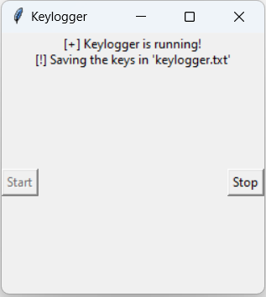
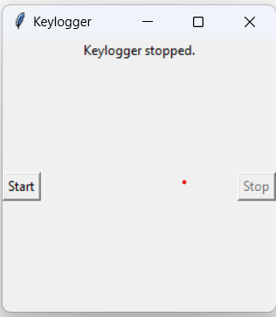

RESULTS
3/21/2024 Annual Review
10

